Slide 1
ONE INNOVATION HUB ARTIFICIAL INTELLIGENCE CLASS
DECISION TREE ALGORITHM

Slide 2
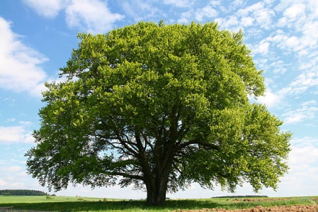
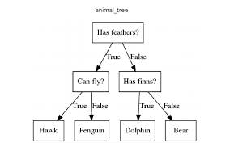
INTRODUCTION

Slide 3
A decision tree is one of the supervised machine learning algorithms.
This algorithm can be used for regression and classification problems — yet, is mostly used for classification problems.
In general, decision trees are constructed via an algorithmic approach that identifies ways to split a data set based on different conditions.

Slide 4
The decisions/predictions are performed on the basis of features of the given dataset which is further based on the nature of the condition given.
Who gives this condition?
In building a tree, the CART algorithm is often used , which stands for Classification and Regression Tree algorithm.

Slide 5
TYPES OF DECISION TREES
Categorical Variable Decision Tree: Decision Tree which has a categorical target variable then it called a Categorical variable decision tree.
Continuous Variable Decision Tree: Decision Tree has a continuous target variable then it is called Continuous Variable Decision Tree.

Slide 6
TERMINOLOGIES IN DECISION TREE
Root Node: This attribute is used for dividing the data into two or more sets. The feature attribute in this node is selected based on Attribute Selection Techniques. It is sometimes called a DECISION NODE.
Branch or Sub-Tree: A part of the entire decision tree is called a branch or sub-tree.

Slide 7
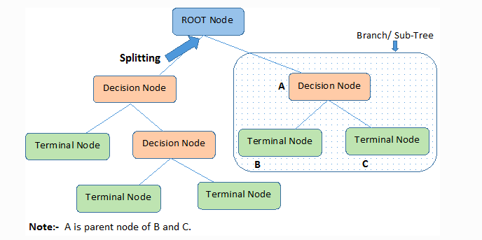
Splitting: the process of dividing a node into two or more sub-nodes based on given conditions.

Slide 8
Decision Node: After splitting the sub-nodes into further sub-nodes, then it is called the decision node.
Leaf or Terminal Node: This is the end of the decision tree where it cannot be split into further sub-nodes.
Pruning: Removing a sub-node from the tree is called pruning. Sometimes referred to as the opposite of splitting.

Slide 9
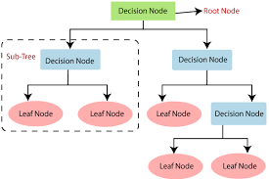

Slide 10
Instances: Refer to the vector of features or attributes that define the input space
Attribute: A quantity describing an instance
Concept: The function that maps input to output
Target Concept: The function that we are trying to find, i.e., the actual answer

Slide 11
Hypothesis Class: Set of all the possible functions
Sample: A set of inputs paired with a label, which is the correct output (also known as the Training Set)
Candidate Concept: A concept which we think is the target concept
Testing Set: Similar to the training set and is used to test the candidate concept and determine its performance

Slide 12
ILLUSTRATION
Let us assume that we want to play football on a particular day, say a Sunday. How do we decide whether or not to play on that day.
As ML experts, we go out to take some parameters which include:
a) Temperature: Is it hot or cold?
b) Weather: Is it sunny, rainy or cloudy?
C) Wind: Is it weak or strong?
D) Player: Are they complete or not?
e) Referee: Is he around or not?

Slide 13
Day | Weather | Temperature | Wind | Players | Referee | Play?
1 | Sunny | Hot | Weak | Incomplete | Unavailable | No
2 | Cloudy | Hot | Weak | Complete | Available | Yes
3 | Sunny | Mild | Strong | Complete | Unavailable | Yes
4 | Cloudy | Mild | Strong | Incomplete | Available | Yes
5 | Rainy | Mild | Strong | Incomplete | Unavailable | No
6 | Rainy | Cool | Strong | Complete | Unavailable | No
7 | Rainy | Mild | Weak | Complete | Available | Yes
8 | Sunny | Hot | Strong | Incomplete | Available | No
9 | Cloudy | Hot | Weak | Complete | Available | Yes
10 | Rainy | Mild | Strong | Incomplete | Unavailable | No

Slide 14
What if the weather pattern on Sunday does not match with any of rows in the table? This may be a problem.
Hence, the idea of a decision tree would be a great way to represent data like this
This is because it takes into account all the possible paths that can lead to the final decision by following a tree-like structure.

Slide 15
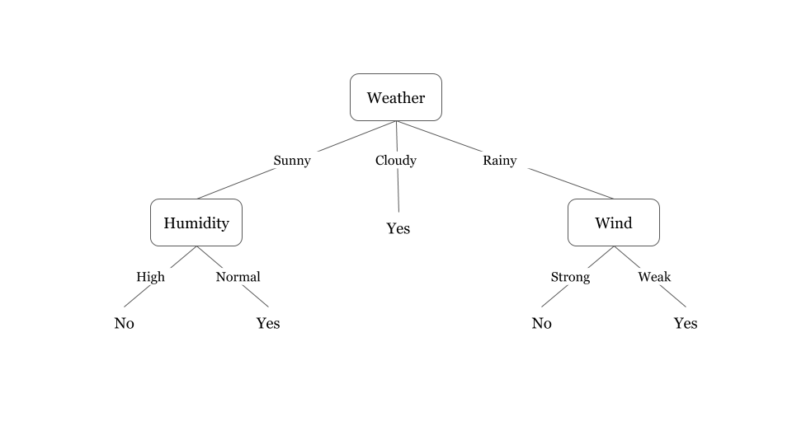

Slide 16
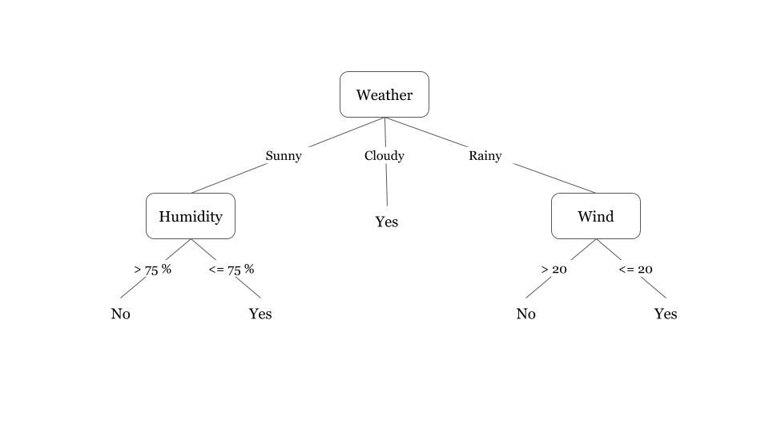

Slide 17
How do decision trees work?
The decision of making strategic splits greatly affects a tree’s accuracy. The decision criteria are different for classification and regression trees.
The decision of making strategic splits heavily affects a tree’s accuracy. The decision criteria are different for classification and regression trees.

Slide 18
The decision tree splits the nodes on all available variables and then selects the split which results in most homogeneous sub-nodes.
Decision trees use multiple algorithms to decide to split a node into two or more sub-nodes.
The algorithm selection is also based on the type of target variables.

Slide 19
Common algorithms used in Decision Trees
ID3 → (extension of D3)
C4.5 → (successor of ID3)
CART → (Classification And Regression Tree)
CHAID → (Chi-square automatic interaction detection Performs multi-level splits when computing classification trees)
MARS → (multivariate adaptive regression splines)

Slide 20
Steps in a Decision Tree
Step-1: Begin the tree with the root node, says S, which contains the complete dataset.
Step-2: Find the best attribute in the dataset using Attribute Selection Measure (ASM).
Step-3: Divide the S into subsets that contains possible values for the best attributes.

Slide 21
Step-4: Generate the decision tree node, which contains the best attribute.
Step-5: Recursively make new decision trees using the subsets of the dataset created in step -3. Continue this process until a stage is reached where you cannot further classify the nodes and called the final node as a leaf node.

Slide 22
Suppose there is a candidate who has a job offer and wants to decide whether he should accept the offer or Not.
To solve this problem, the decision tree starts with the root node (Salary attribute by ASM). The root node splits further into the next decision node (distance from the office) and one leaf node based on the corresponding labels. The next decision node further gets split into one decision node (Cab facility) and one leaf node. Finally, the decision node splits into two leaf nodes (Accepted offers and Declined offer).

Slide 23
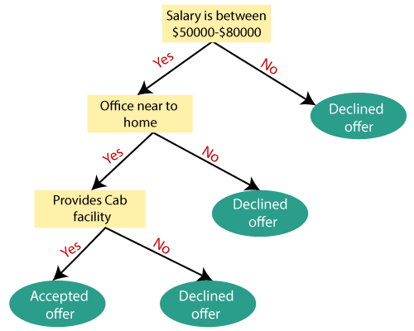

Slide 24
The main question is?
How is the model to select the best attribute for the root node and for the sub-nodes?
Attribute Selection Measures (ASM) is the solution.

Slide 25
ATTRIBUTE SELECTION MEASURES
To solve the attribute selection problem, the following criteria can be used:
1. Information gain
2. Gini index
3. Entropy
4. Gini ratio

Slide 26
ENTROPY
Entropy is a measure of the randomness in the information being processed.
The higher the entropy, the harder it is to draw any conclusions from that information.
Flipping a coin is an example of an action that provides information that is random.

Slide 27
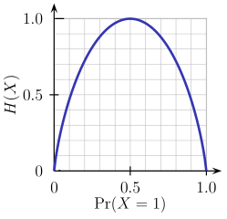
it is quite evident that the entropy H(X) is zero when the probability is either 0 or 1. The Entropy is maximum when the probability is 0.5 because it projects perfect randomness in the data and there is no chance of perfectly determining the outcome. The higher the entropy, the more the information content

Slide 28
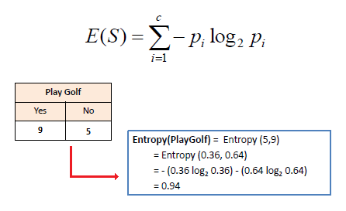
S → Current state, and Pi → Probability of an event i of state S or Percentage of class i in a node of state S.

Slide 29
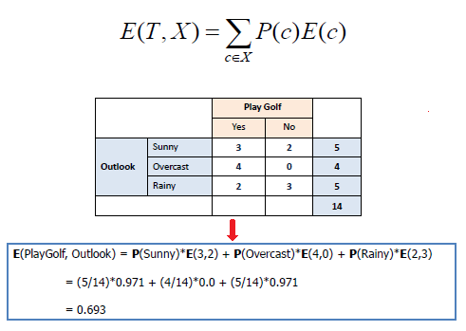
ENTROPY FOR MULTIPLE ATTRIBUTES
where T→ Current state and X → Selected attribute

Slide 30
INFORMATION GAIN
Information gain or IG is a statistical property that measures how well a given attribute separates the training examples according to their target classification.
Constructing a decision tree is all about finding an attribute that returns the highest information gain and the smallest entropy.

Slide 31
INFORMATION GAIN
It is the measurement of changes in entropy after the segmentation of a dataset based on an attribute.
It calculates how much information a feature provides us about a class.
According to the value of information gain, we split the node and build the decision tree.
A decision tree algorithm always tries to maximize the value of information gain, and a node/attribute having the highest information gain is split first

Slide 32
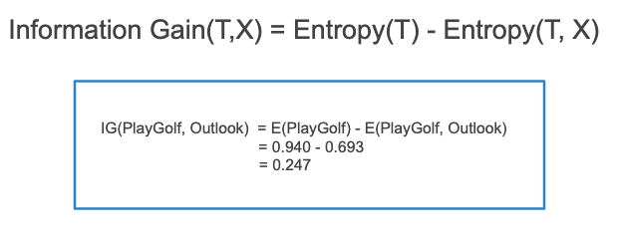

Slide 33
GINI INDEX
Gini index is a measure of impurity or purity used while creating a decision tree in the CART(Classification and Regression Tree) algorithm.
Gini Index is a metric to measure how often a randomly chosen element would be incorrectly identified.
An attribute with the low Gini index should be preferred as compared to the high Gini index.

Slide 34
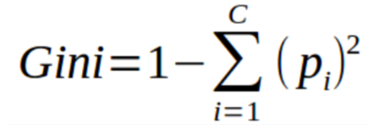
It only creates binary splits, and the CART algorithm uses the Gini index to create binary splits.
Sklearn supports “Gini” criteria for Gini Index and by default, it takes “gini” value.

Slide 35
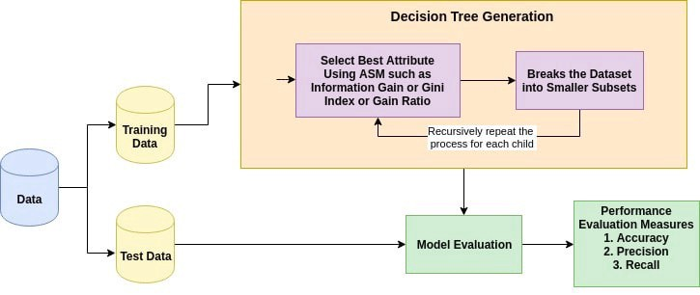

Slide 36
References
Chowdary D.H (May 28, 2020). Decision Tress Explained with a Practical Example https://towardsai.net/p/programming/decision-trees-explained-with-a-practical-example-fe47872d3b53
Gupta P. (May 17, 2017). Decision Trees in Machine Learning https://towardsdatascience.com/decision-trees-in-machine-learning-641b9c4e8052

Slide 37
Decision Tree Classification Algorithm https://www.javatpoint.com/machine-learning-decision-tree-classification-algorithm
Chauhan N.S. (Feb 9, 2022). Decision Tree Algorithm, Explained https://www.kdnuggets.com/2020/01/decision-tree-algorithm-explained.html

